Slide 1
Backward General-purpose ray-tracer for Polarized Neutron Imaging Simulation (BGPNIS)*
A brute-force & robust numerical solver for synthesizing 2D polarized neutron transmission scans
Presenter: Shuhan Zheng
*Tentative name

Slide 2
Background
In a neutron experiment, the neutron port should be viewed as a diffusive source. Each neutron travels in a random direction with a random polarization.
With 3He filters, all the different polarizations are “unified”.
Neutrons’ Larmor Precession depends on its path. With a diffusive source and a 2D detecting surface, it is impossible to analytically determine a neutron’s path based on where it contacts the surface.
Ray-tracers come to rescue!

Slide 3
Forward ray-tracing
Source
n
n
n
n
n
n
n
n
n
n
n
n
n
n
Rays go from source to detector
Each ray path is calculated numerically (slow!)
Mimics the physical world (realistic & accurate)
Not all particles end up in the detector
Computationally expensive
n
neutrons
Sample
Analyzer & detector

Slide 4
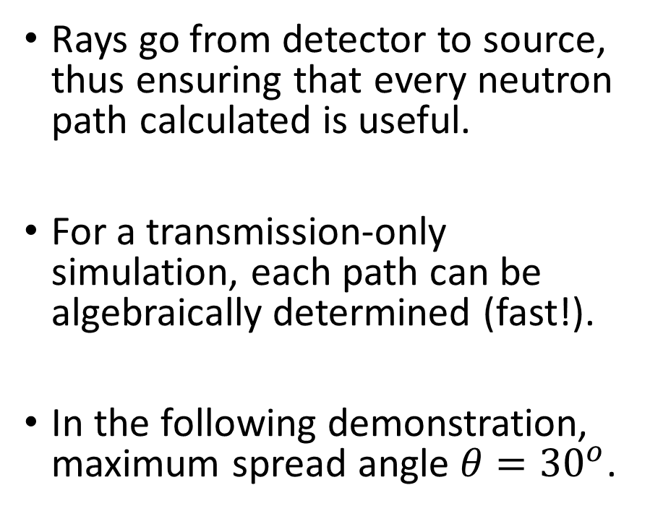
Backward ray-tracing
Source
Simulated ray
Rays go from detector to source, thus ensuring that every neutron path calculated is useful.
For a transmission-only simulation, each path can be algebraically determined (fast!).
In the following demonstration, maximum spread angle $θ={30}^{o}$.
Sample
θ
Analyzer & detector

Slide 5
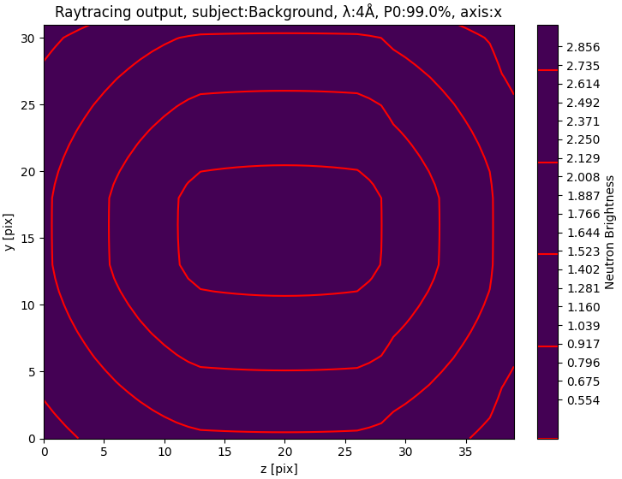
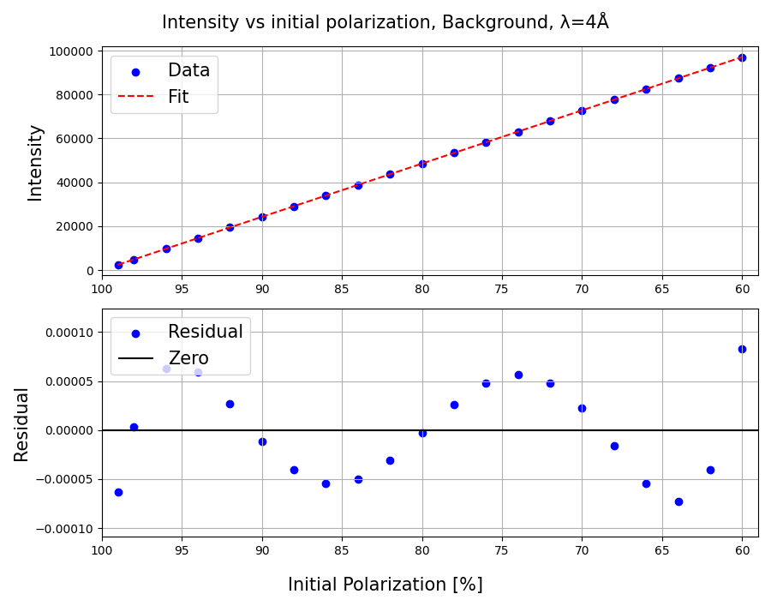
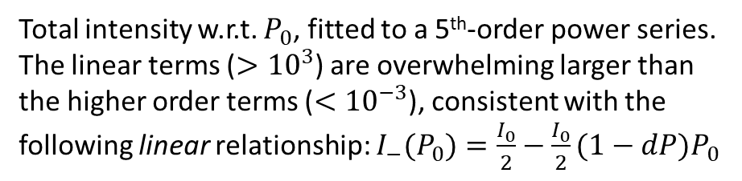
2D Gaussian beam profile, intensity map
(σ = 1*figure size, centered)
Total intensity w.r.t. $P_{0}$, fitted to a 5th-order power series.
The linear terms ($>{10}^{3}$) are overwhelming larger than the higher order terms ($<{10}^{−3}$), consistent with the following linear relationship: $I_{−}(P_{0})=\frac{I_{0}}{2}−\frac{I_{0}}{2}(1−dP)P_{0}$

Slide 6
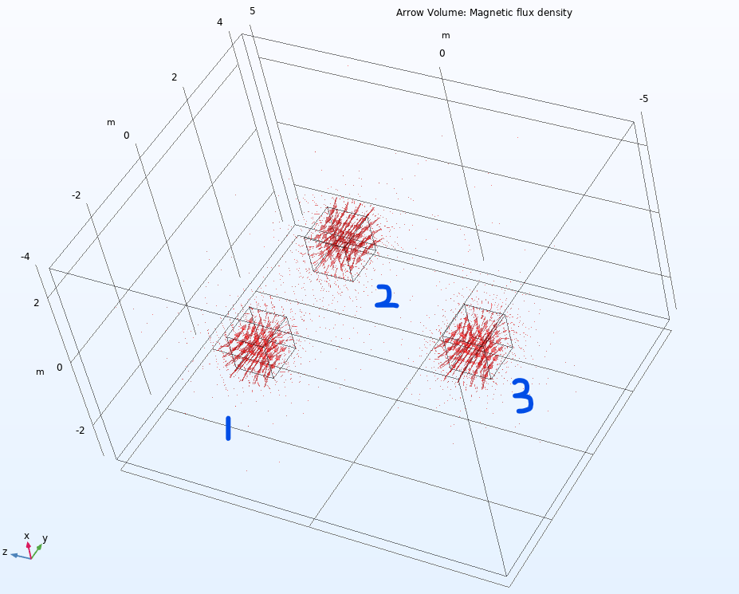
Simulation set up
Three cubes of equal magnetization.
They are on the same x-z plane but staggered in all other directions.
Cube #2 is oriented opposite to others.
The arrow volume is set to have 24, 32, and 40 points in x, y, and z directions, respectively.
Detector is on y-z plane, at x = 0

Slide 7
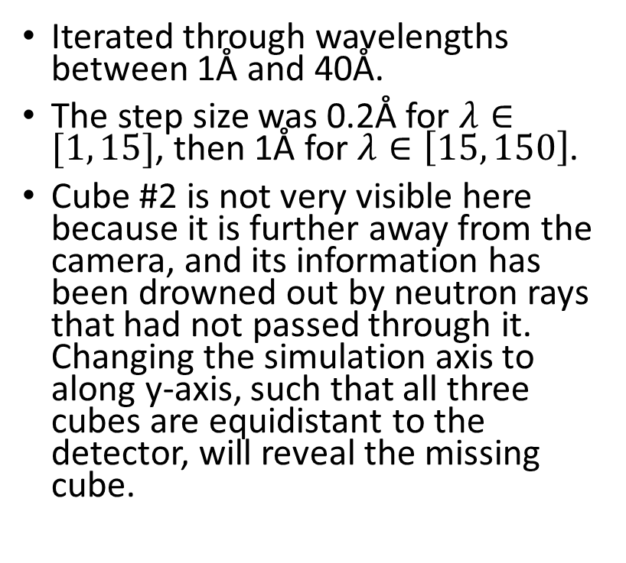
Simulation summary
Iterated through wavelengths between 1Å and 40Å.
The step size was 0.2Å for $λ∈[1, 15]$, then 1Å for $λ∈\left[15, 150\right]$.
Cube #2 is not very visible here because it is further away from the camera, and its information has been drowned out by neutron rays that had not passed through it. Changing the simulation axis to along y-axis, such that all three cubes are equidistant to the detector, will reveal the missing cube.
Neutron brightness as measured by the detector, after passing through an analyzer (above).

Slide 8
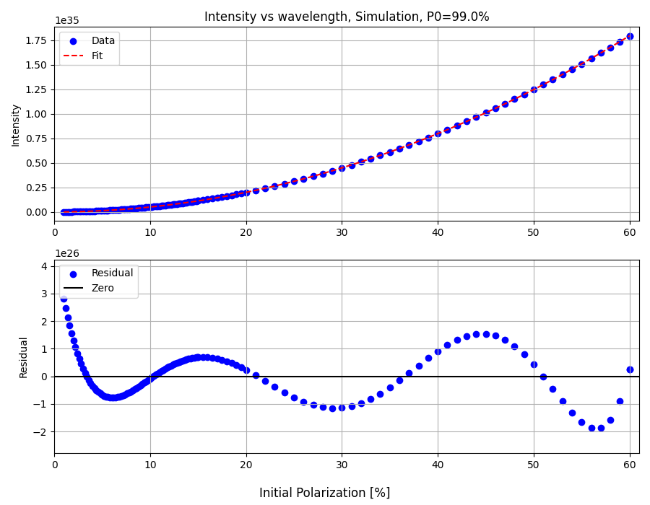
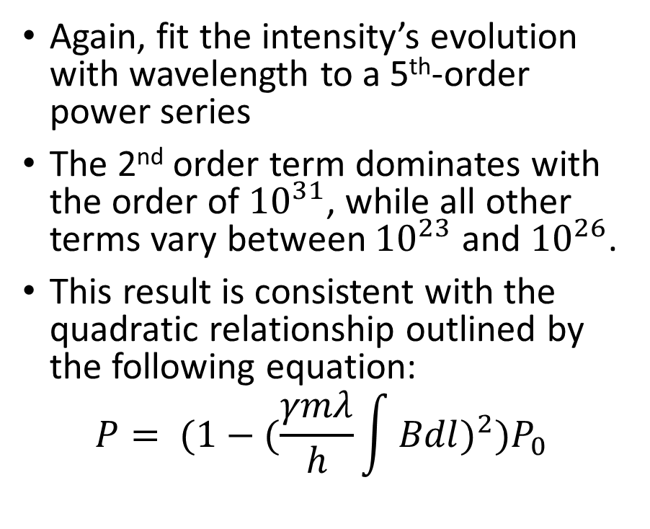
Post-simulation analysis
Again, fit the intensity’s evolution with wavelength to a 5th-order power series
The 2nd order term dominates with the order of ${10}^{31}$, while all other terms vary between ${10}^{23}$ and ${10}^{26}$.
This result is consistent with the quadratic relationship outlined by the following equation:
$${P= (1−(\frac{γmλ}{h}\int{Bdl})}^{2})P_{0}$$

Slide 9
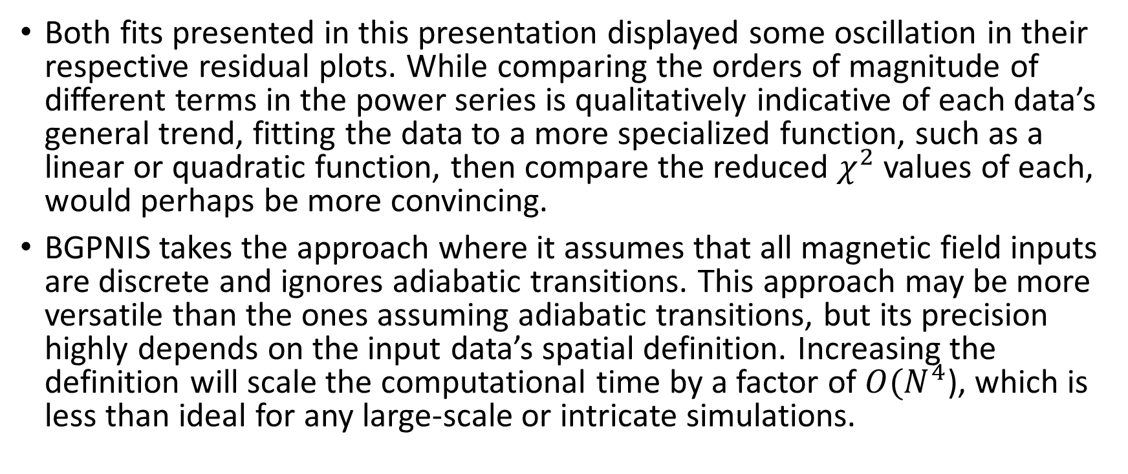
Discussion
Both fits presented in this presentation displayed some oscillation in their respective residual plots. While comparing the orders of magnitude of different terms in the power series is qualitatively indicative of each data’s general trend, fitting the data to a more specialized function, such as a linear or quadratic function, then compare the reduced $χ^{2}$ values of each, would perhaps be more convincing.
BGPNIS takes the approach where it assumes that all magnetic field inputs are discrete and ignores adiabatic transitions. This approach may be more versatile than the ones assuming adiabatic transitions, but its precision highly depends on the input data’s spatial definition. Increasing the definition will scale the computational time by a factor of $O(N^{4}$), which is less than ideal for any large-scale or intricate simulations.

